Slide 1

Mini project on
ON
“Blog Website”
PRESENTED BY ROLL NO.
Mr.Pruthviraj Rajendra Chavan 08
Mr.Prathamesh Prakash Mandavkar 31
Mr.Dhruv Sanjay Sambrekar 52
Mr.Shreyas Shridhar Phansalkar 45
Mr.Ganesh Hanmant Pawar 43
Under the Guidance of
Prof.S.D.BHOPALE.
Department of Computer Science and Engineering
Dr. D. Y. Patil Pratishthan’s College of Engineering
Shivaji University, Kolhapur
2021-2022

Slide 2
Content | PG.NO
INTRODUCTION | 3-4
PROBLEM STATEMENT | 5
ADVANTAGES | 6
OBJECTIVES | 7
REQUIREMENT ANALYSIS | 8
SOFTWARE REQUIREMENTS | 9
PROJECT PHASES | 11
DATA FLOW DIAGRAM | 12-14
FUTURE ENHANCEMENTS | 20
CONCLUSION | 21
REFERENCE | 22

Slide 3
Introduction
A blog is a type of website that is updated regularly with new content
Most blogs contain short, informal articles called blog posts
These posts usually contain some combination of text, photos, videos, and other media.
At its core, a blog is just a space on the Web that you can create to record and express your opinions, experiences, and interests.

Slide 4
If you spend much time browsing the Web, you've probably read a blog post before, even if you didn't realize it at the time.
Some of the most-read blogs are a bit like online magazines because they're written by a team of people who are paid to update the blog with new posts several times a day.

Slide 5
Problem Statement Existing system is manual system. It requires à lot of file work to be done. It is a timeconsuming system, All customer information is maintained manually,Any searching requires so much effort manually.You do not get unlimited space for writing your content.
some persons cannot share their information or there own perspective , knowledge in the form of video and audio format . That’s why they share there points our perspectives in the form of document on blog in the form of webpage.

Slide 6
Advantages of Proposed System – 1. Extend Your Knowledge About Programming 2. Land Better and More Opportunities 3. Grow Your Network 4. Improve Your Communication Skills 5. An Organized Place for a Portfolio

Slide 7
Objectives
The main objective of this webapp is to share information and comment on blog for your own response.
The purpose of a blog is to provide content on your website that answers your prospective customers' questions and helps them learn about your product or service.
The system contains more security comparing to other websites.
This webblog is very beneficial for professional work .

Slide 8
Requirement Analysis
A lot of paper is needlessly wasted in the traditional evaluation process. Wasting such a valuable environmental resource often goes against the institution’s ‘green’ initiatives and university Wide goals.
Many times to the customers they don’t have computers , so they could face problem , we come up to this with solution of mobile ,as now days everyone has mobile phones so they can blog through it.

Slide 9
Software requirements
Languages Used :-
HTML, CSS(Bootstrap),python.
Hardware specification:-
Processor: intel core duo
RAM: 1 GB
Hard disk:20 GB
software specification:-
Browser: javascript enabled
OS: windows 7 or higher, linux

Slide 10
Project Phases
Literature survey
Design and Devlopment
Implementation
Testing
Result and discussion

Slide 11
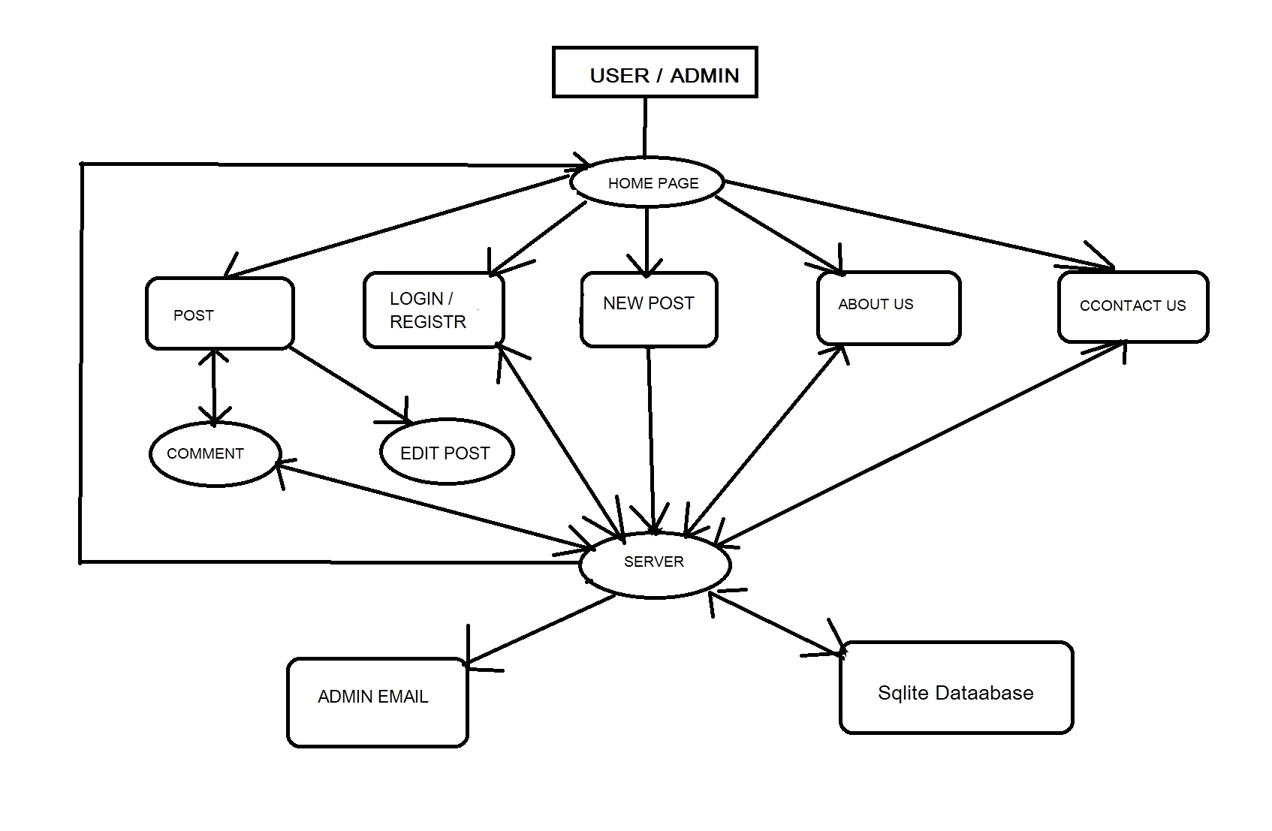
Project flow Diagram

Slide 12
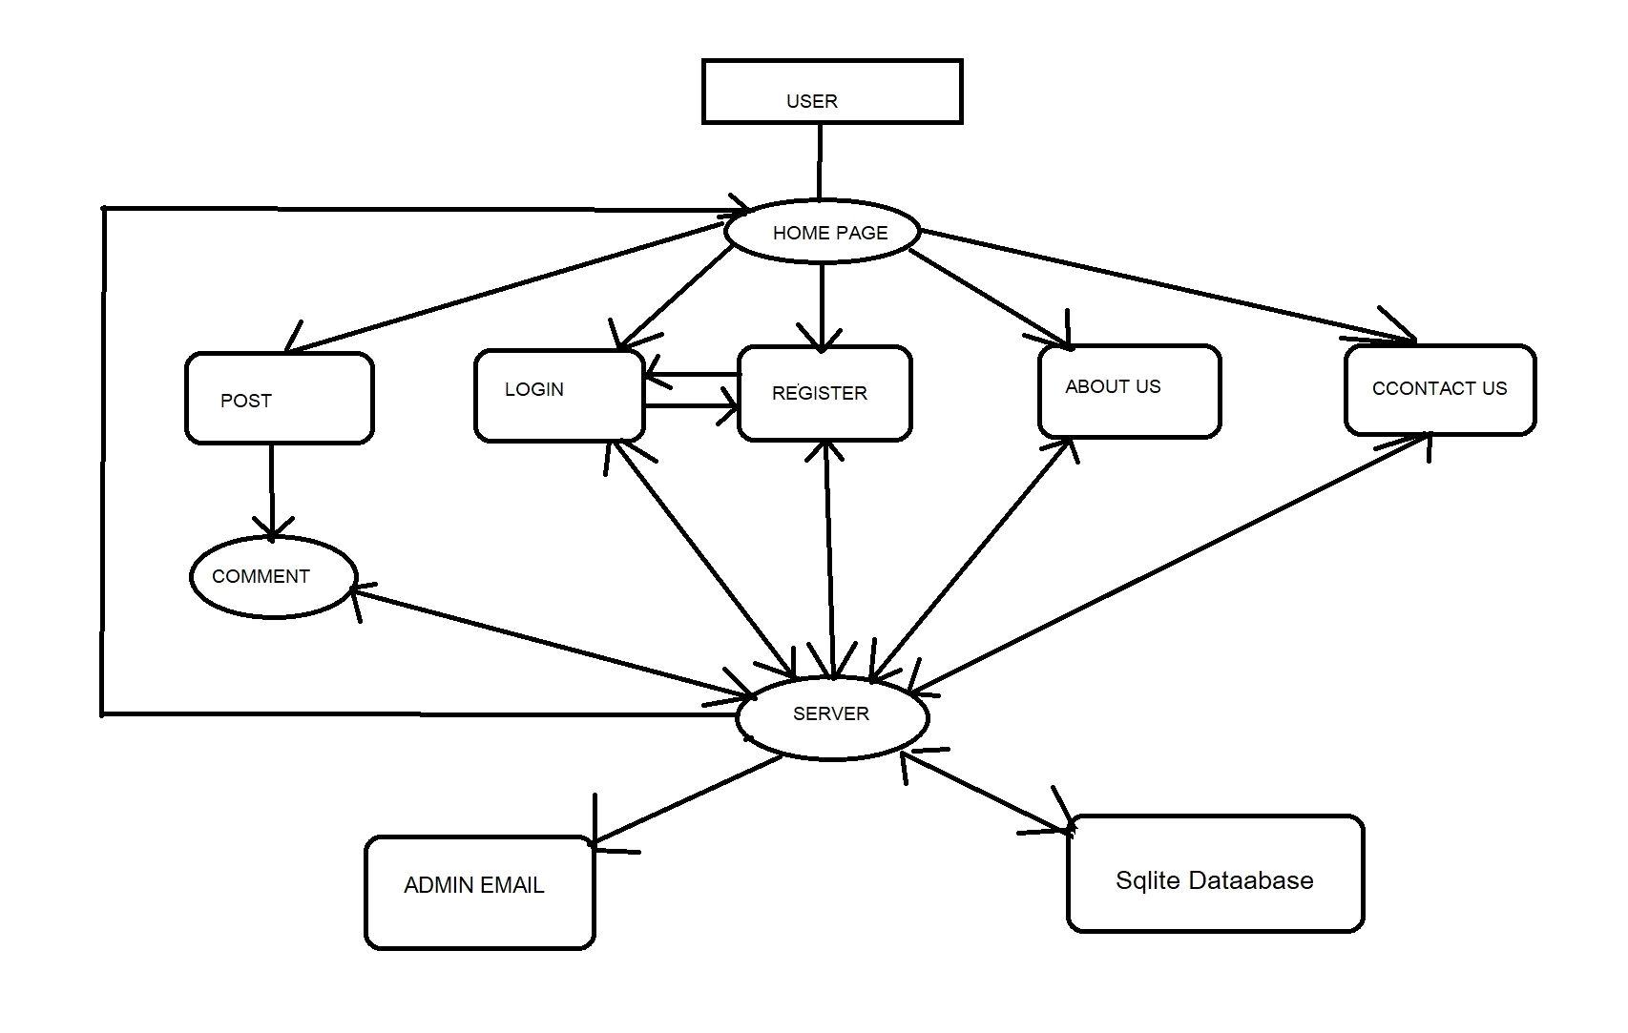
DESIGN
Fig-User dataflow Diagram

Slide 13
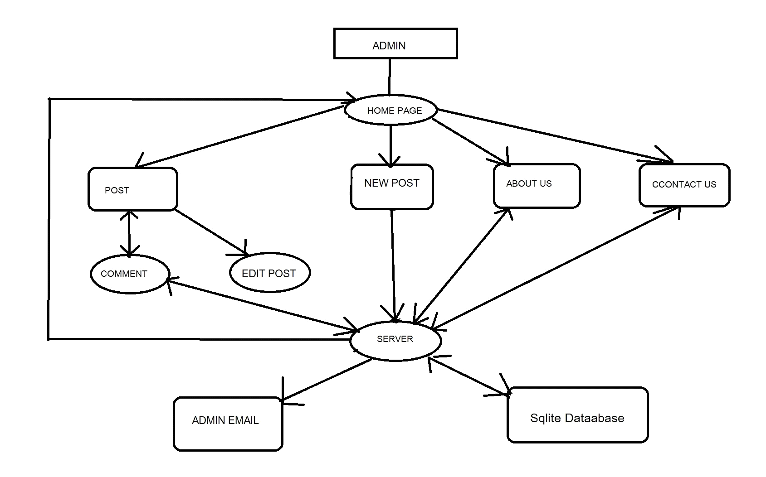
Admin dataflow Diagram

Slide 14
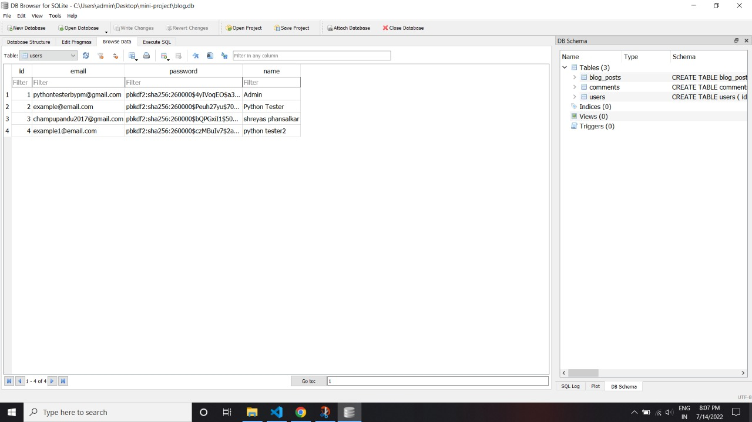

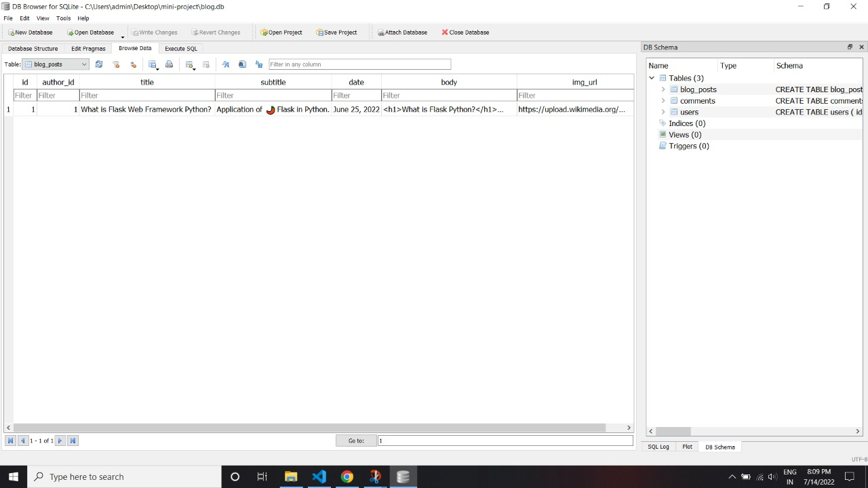
Database (table design):

Slide 15
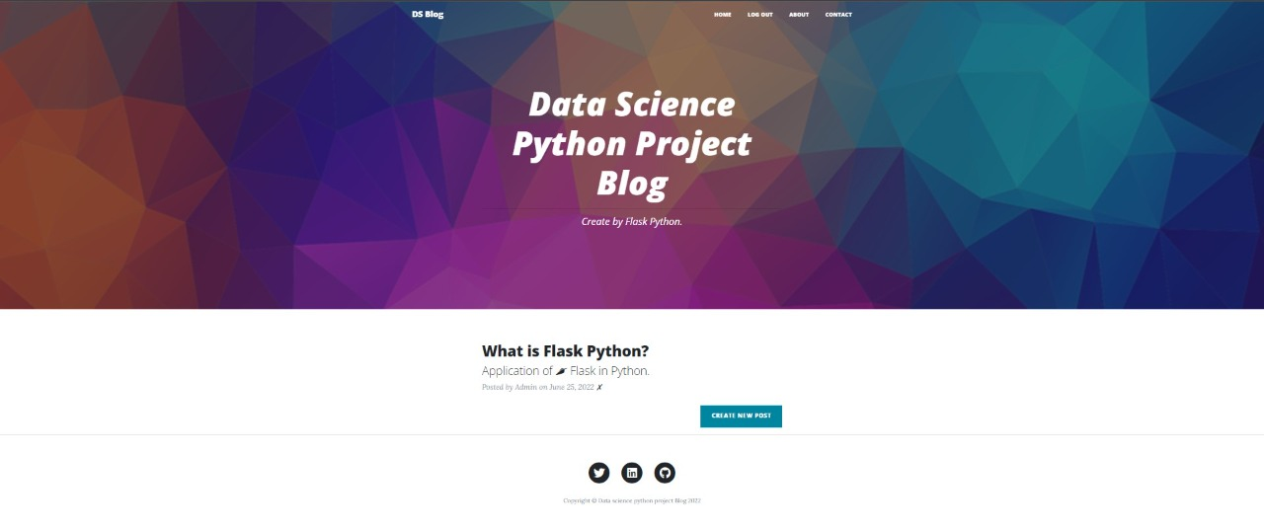
IMPLEMENTATION

Slide 16
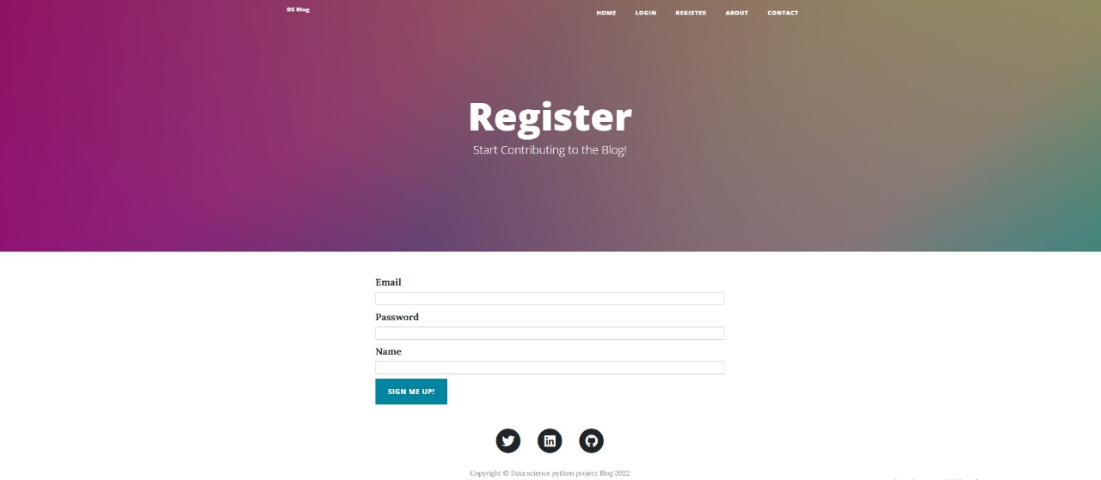
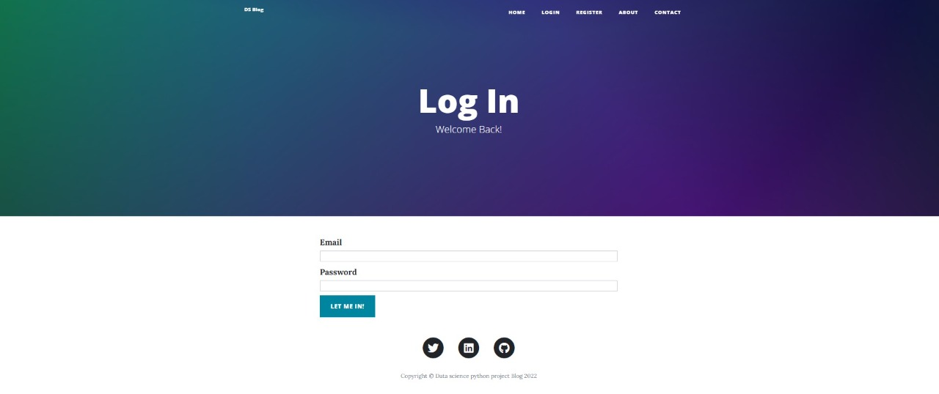

Slide 17
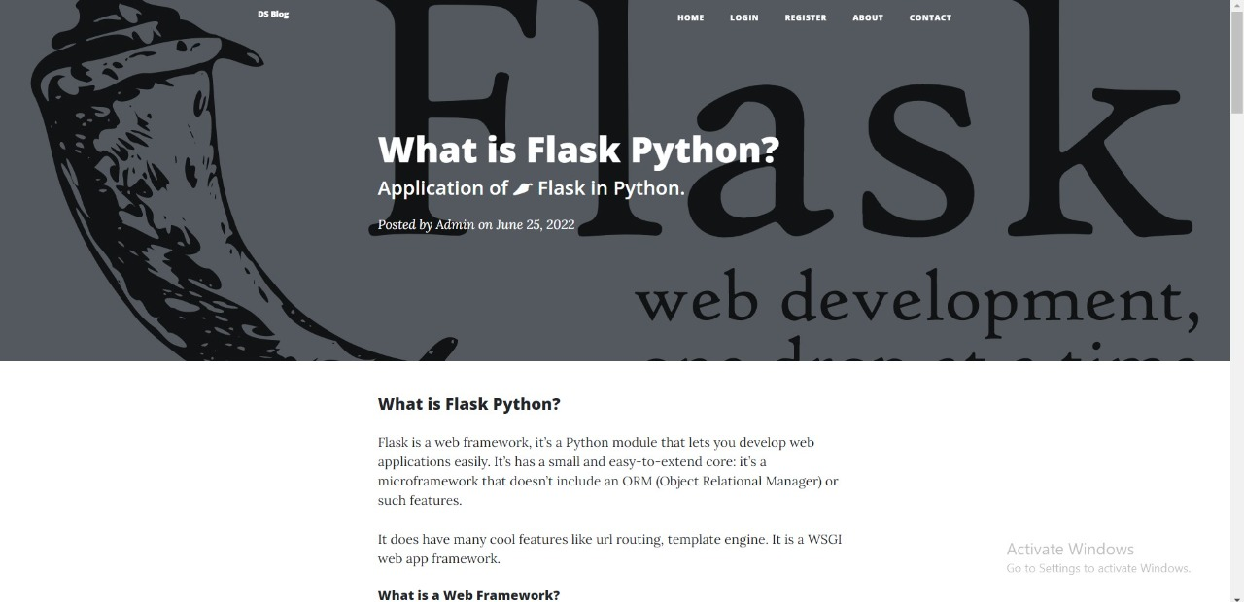
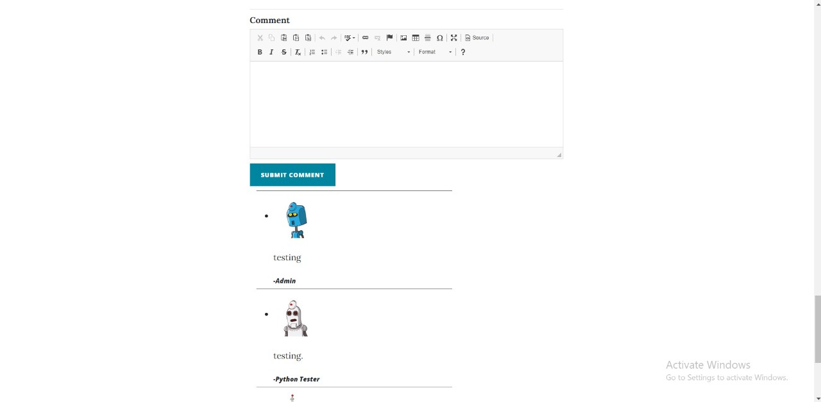

Slide 18
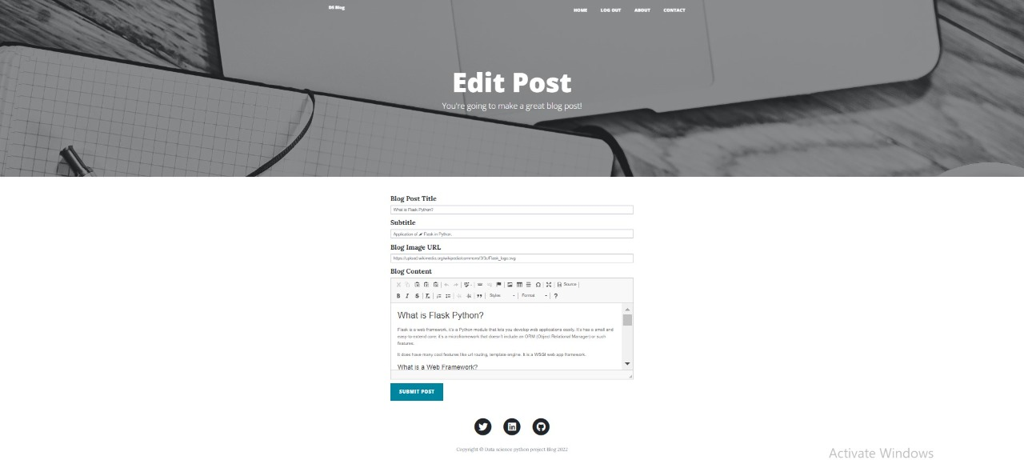
Editing post

Slide 19
Future enhancement
The Blog webSite have wide range to change as per time requirement. That the reason behind that not a particular project is ever considered as complete, because what the demand of user and thinking always change day by day
We will show advertisement on blog.
We will give access to user to create and edit the post.
We will create password forgot page.
We will give access to user for delete and edit their comment

Slide 20
Conclusion
We created blog project using flask in python , when we start to create this project we learned about frontend technology like HTML-CSS, jinja, bootstrap. and For backend technology like flask, flask_wtf, functools, werkzeug,flask_sqlalchemy, wtforms, flask_ckeditor, flash_login, flask_gravatar & smtplib . for database we used SQLite-database.

Slide 21
References:
1.www.flaask.pallets.com
2. www.webgradiant.com
3. www.w3school.com
4. www.wikiped

Slide 22
THANK YOU

